Slide 1
Optical-Guided Super-Resolution for Thermal IR Imagery
CSE7302- University Project
Review-1
Batch Number: CAI_5
Under the Supervision of,
Dr. Yamanappa
Assistant Professor
School of Computer Science and Engineering
Presidency University
Roll Number | Student Name
20221CAI0051 | Chunchu Saisree
20221CAI0044 | G.A. Videesh Reddy
20221CAI0057 | Kamparaju Keshasree
Name of the Program: B.TECH
Name of the HoD: Dr. Zafar Ali Khan N
Name of the Program Project Coordinator: Ms.Suma N G
Name of the School Project Coordinators: Dr. Sampath A K , Dr. Geetha A

Slide 2
Problem Statement Number: 166 (SIH25171)
Organization : Indian Space Research Organisation (ISRO)
Category (Hardware / Software / Both) : Software
Problem Description :
Thermal infrared (IR) cameras are very helpful in night-time and low-light situations because they detect heat instead of light. However, most thermal cameras produce low-resolution images due to sensor limitations and the high cost of high-resolution thermal devices. Because of this, thermal images often look blurry and unclear, which can reduce performance in applications like surveillance, object detection, and security monitoring. To overcome this problem, our project improves the quality of thermal IR images using super-resolution techniques guided by aligned high-resolution optical (RGB) images, so that the final thermal output becomes sharper, clearer, and more detailed.

Slide 3
Content
Objectives
Background and Related work for title Selection
Analysis of Problem Statement
Innovation or Novel Contributions
Git-hub Link
Timeline of the Project
References

Slide 4
Objectives
Build an Optical-Guided Super-Resolution (OGSR) system for thermal IR.
Use aligned optical images as guidance to reconstruct high-resolution thermal data.
Improve performance for tasks like:
object detection
surveillance
monitoring in low-light/night
Evaluate with:
PSNR
SSIM
Visual comparison results

Slide 5
Background and Related work
Thermal IR captures heat signatures
Works in dark/night conditions
Robust to lighting changes
But thermal sensors are expensive → usually low resolution
Optical RGB images have:
fine edges
textures
Details
So optical images can guide thermal SR.

Slide 6
Analysis of Problem Statement
Current Challenges
Thermal IR cameras are extremely useful in dark/night conditions, but most thermal images are low-resolution.
Low resolution causes:
blurred objects
unclear boundaries
loss of fine details (edges, textures)
High-resolution thermal cameras exist, but they are very costly, so they are not affordable for many real-world applications.
Due to these issues, thermal IR systems struggle in tasks like surveillance, monitoring, detection, and tracking.

Slide 7
Analysis of Problem Statement (contd...)
Needs & Expectations
Need a method to increase thermal image quality without upgrading expensive thermal hardware.
The solution should:
improve sharpness and clarity
preserve real heat patterns (thermal consistency)
avoid fake textures that can mislead analysis
Since optical (RGB) images are high-resolution and cheap, we expect to use RGB as a guidance source to recover:
Edges
object shapes
structural information

Slide 8
Analysis of Problem Statement (contd...)
Expected Outcome / Impact
A model/system that converts Low-Resolution Thermal → High-Resolution Thermal using optical guidance.
Final enhanced thermal images will be:
sharper and clearer
better object boundaries
more useful for detection and monitoring
This improves overall performance in applications like:
night security surveillance
rescue operations
defense monitoring
industrial inspection

Slide 9
Github Link
The Github link provided should have public access permission.
Github

Slide 10
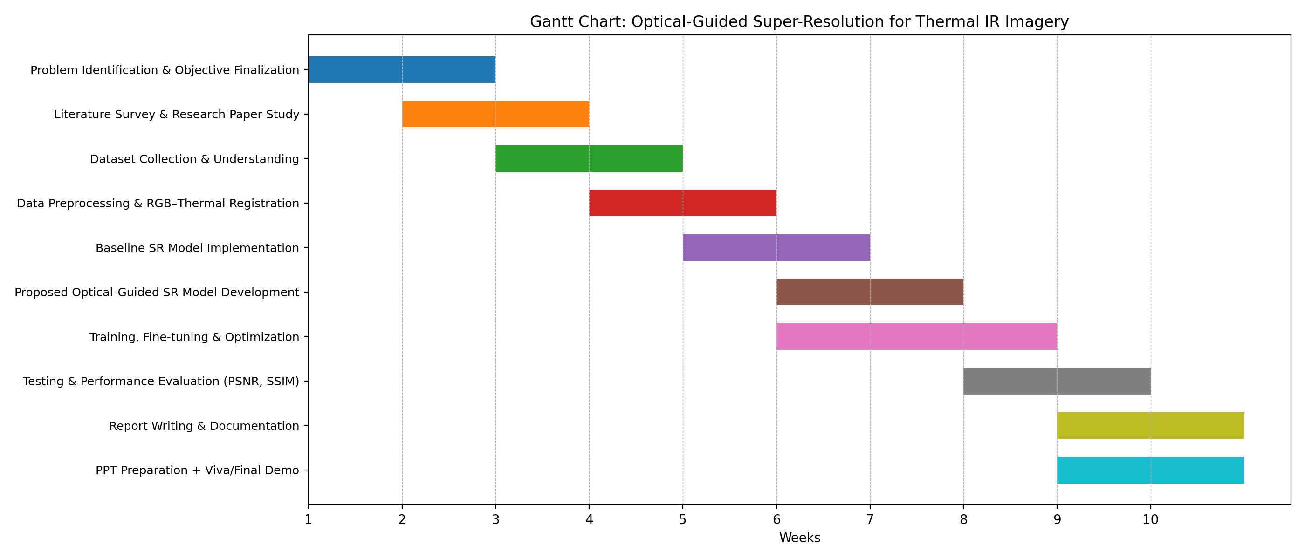
Timeline of the Project (Gantt Chart)

Slide 11
References (IEEE Paper format)
[1] C. Dong, C. C. Loy, K. He, and X. Tang, “Image Super-Resolution Using Deep Convolutional Networks,” IEEE Transactions on Pattern Analysis and Machine Intelligence, vol. 38, no. 2, pp. 295–307, Feb. 2016.
[2] B. Lim, S. Son, H. Kim, S. Nah, and K. M. Lee, “Enhanced Deep Residual Networks for Single Image Super-Resolution,” in Proc. IEEE Conf. Computer Vision and Pattern Recognition Workshops (CVPRW), 2017, pp. 1132–1140.
[3] X. Wang, K. Yu, S. Wu, J. Gu, Y. Liu, C. Dong, Y. Qiao, and C. C. Loy, “ESRGAN: Enhanced Super-Resolution Generative Adversarial Networks,” in Proc. European Conf. Computer Vision (ECCV) Workshops, 2018.
[4] W. Shi, J. Caballero, F. Huszár, J. Totz, A. P. Aitken, R. Bishop, D. Rueckert, and Z. Wang, “Real-Time Single Image and Video Super-Resolution Using an Efficient Sub-Pixel Convolutional Neural Network,” in Proc. IEEE Conf. Computer Vision and Pattern Recognition (CVPR), 2016, pp. 1874–1883.
[5] S. Hwang, J. Park, N. Kim, Y. Choi, and I. S. Kweon, “Multispectral Pedestrian Detection: Benchmark Dataset and Baseline,” in Proc. IEEE Conf. Computer Vision and Pattern Recognition (CVPR), 2015, pp. 1037–1045.

Slide 12


